Slide 1

Extraction methods for Yeasts
Knowledge that will change your world
2nd UAB Metabolomics Workshop
June 2-5, 2014
2014 UAB Metabolomics Workshop

Slide 2
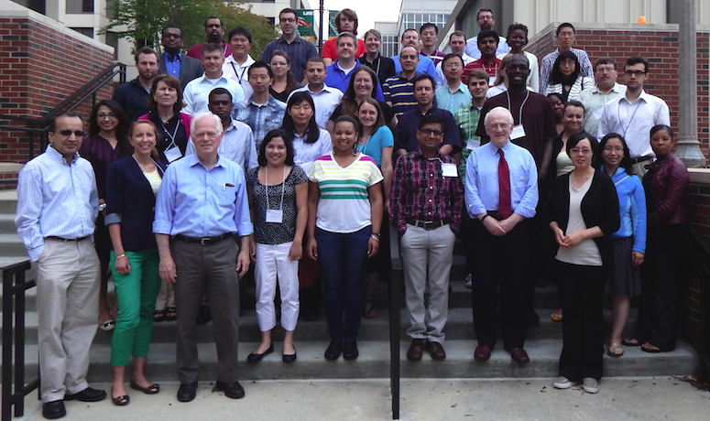
2004 Workshop Attendees and Faculty

Slide 3
How were the yeast cells extracted?
Method 1:
  Quench: -80°C, 80% MeOH
  Extract: 80% MeOH, 100% Chloroform 30 minutes at room temperature
Method 2:
  Quench: -80°C, 80% MeOH
  Extract: -80°C, 80% MeOH, 100% Chloroform 30 minutes in a dry ice/EtOH bath at -43ºC
Method 3:
  Quench: ice-cold dH₂O
  Extract: -80°C, 80% MeOH, 100% Chloroform 30 minutes in a dry ice/EtOH bath
Method 4:
  Quench: ice-cold PBS
  Extract: -80°C, 80% MeOH, 100% Chloroform 30 minutes in a dry ice/EtOH bath

Slide 4
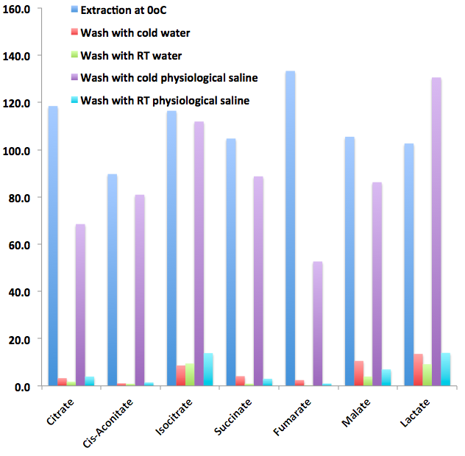
Targeted analysis of yeast extracts
Extraction at 0ºC is as good as at -40ºC
Washing the cells before extraction with warm or ice-cold water causes a loss of these metabolites. Washing with ice-cold PBS is ok, but if the PBS is warm, then it doesn’t work. There are heavy losses of these metabolites before extraction.

Slide 5
Method 1 versus method 2
-log p-value
Fold change : Method 2/Method 1
Method 1 is better
Method 2 (all steps sub-zero) does not extract total metabolites as well as method 1 (room temp extraction)
Log₂Fold change

Slide 6
Method 1 versus method 3
Fold change = Method 3/Method 1
Sub-zero MeOH wash (1) vs cold H₂O wash (3)
Method 1 is better
Log₂Fold change

Slide 7
Method 1 versus method 4
Fold change = Method 4/Method 1
Sub-zero MeOH wash (1) vs cold PBS wash (4)
Method 1 is better
Log₂Fold change

Slide 8
Method 2 versus method 3
Best method (2) vs method 3 (H₂O wash)
Log₂Fold change

Slide 9
Method 2 versus method 4
Best method (2) vs method 4 (PBS wash)
Log₂Fold change

Slide 10
Method 3 versus method 4
Water wash vs PBS wash
Log₂Fold change

Slide 11
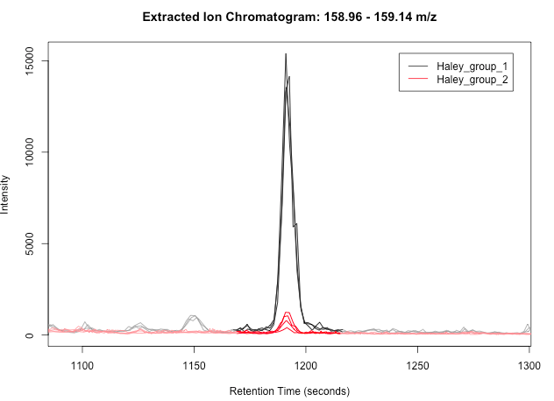
Most significant peak for Method 1 versus Method 2

Slide 12
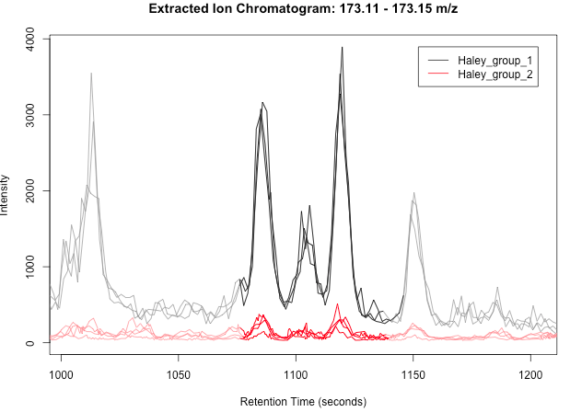
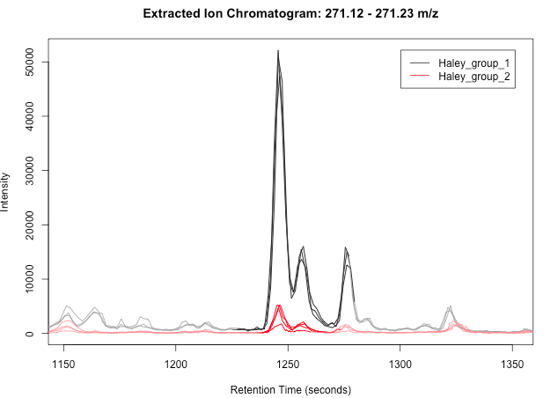
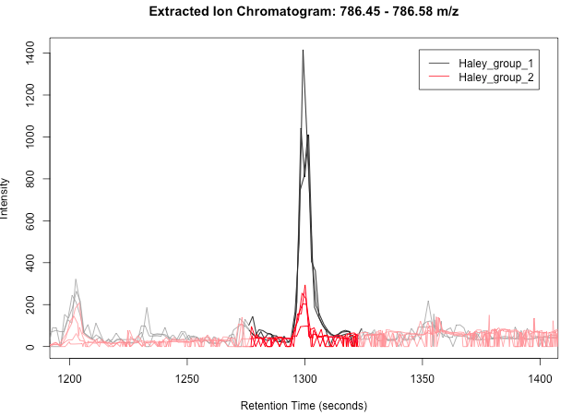
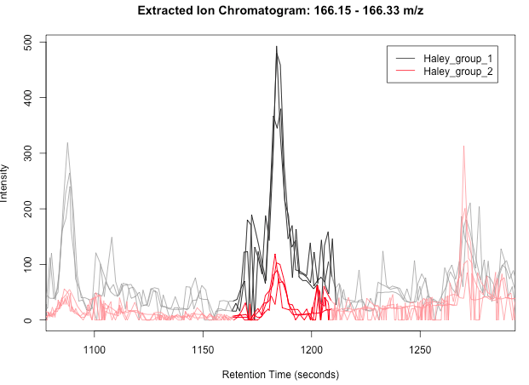

Slide 13
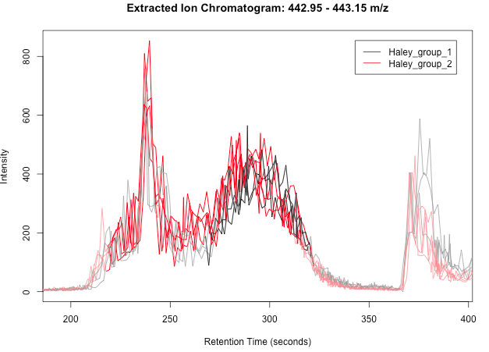
Is this a peak we want to study?

Slide 14
IDs from Metlin for the Top 10 most significant ions between Meth1/Meth2
159.0808
173.1169 oxo-nonanoic acid (several isomers)
237.1353 none
301.1246 none
271.1537 none
364.1654 peptide??
786.4584 Leucomycin A1
187.0992 none
475.2362 ?peptides
462.2316 peptides/Pimozide
363.1847 peptides

Slide 15
Acknowledgements
The NIH Common Fund
The outside Faculty
  Kathleen Stringer
  Grier Page
  Stanley Hazen
  Keith Baggerly
  Xiuxia Du
  Paul Benton
  Dean Jones
  Wimal Pathmasiri
  Rod Snyder
Metabolon
From UAB
  Haley Albright
  Sean Wilkinson
  Matt Renfrow
  Janusz Kabarowski
  Jeevan Prasain
  Landon Wilson
  Ray Moore
  Ali Arabshahi
  Ron Shin
  Ramu Krishna
  Krista Casazza
  Lalita Shevde-Samant
  Adam Wende
Office of Vice President-Research
Dean’s Office SOM
CCC, CDC
DRTC
O’Brien AKI
Facilitated by
  Hemant Tiwari
  Jennifer Spears
  Mikako Kawai
  David Graves
  Mary-Ann Bjornsti

